Slide 1

“Chance Quality” Model for Football Shots (Task – 1)
Predicting Goal Probability of a Shot
Aritra Majumdar
16.06.2024

Slide 2
INTRODUCTION
Objective: The aim is to measure the quality of a chance by calculating the probability of a shot resulting in a goal.
If the probability of a shot (i.e., chance of scoring) going inside the goal is 0.13, that means if the shot is taken 100 times, the chance of the shot going inside the goal is 13 times (i.e., 13% chance of scoring).
Methodology:
Aim to model: Shot Outcome ~ Set of features/ variables
Data Pre-processing, Feature Engineering (Converting the positions to OPTA co-ordinates, Encoding categorical columns to numerical using fixed mappings)
Feature Selection (Selecting relevant variables for modelling)
Feature creation (New features such as Distance to goal, Distance to the two goal posts, Shot angle (i.e., the angle to the goal), Pitch zone (i.e., from where the shot is taken)
Model selection (XGBoost, Artificial Neural Network, Logistic Regression)
Model training (Initial Model training to determine model parameters)
Model parameter determine
Model evaluation (Evaluation metrics - Brier score, RMSE, AUC, Classification report, Confusion Matrix)
Model interpretation (Interpretation of the evaluation metrics, Explaining the output of the model (i.e., SHAP, Overall feature importance, and Single shot prediction variable importance)
Results (Presentation of the results)
Visualization of results on the Pitch

Slide 3
Core Questions and Essential Notes
Questions to Address
Key Notes
Coordinate Conversion: All coordinates have been converted to OPTA format.
Notebook References: Each slide with visualizations or results references a specific .ipynb file containing the relevant code.
Reproducibility: All provided .ipynb files are reproducible, with functions for each operation.
Data Pre-processing Functions: read_file, preprocessing, distance_calculation, angle_calculation, assign_zone drop_columns, cat_to_num, X_y
Model-specific Functions: split, split_ANN, scaler_transformation, pca_transformation, sampling, classifier_ML, classifier_ANN, evaluation_metrics, prediction, loss_eval, accuracy_eval
Visualization-specific Functions: cal_cur, cal_shap_values, overall_feature_importance, single_instance_importance, roc_curve_plot, precision_recall_curve_plot, plot_shot_with_annotations, plot_shot
Why opt for XGBoost, Artificial Neural Networks (ANN), and Logistic Regression in our predictive modeling?
What are the key evaluation metrics critical for assessing the performance of our machine learning models?
Which variables play a significant role in determining the likelihood of a shot resulting in a goal?
Is our objective to accurately predict the majority of goals, or to closely estimate the probability of each individual shot?

Slide 4
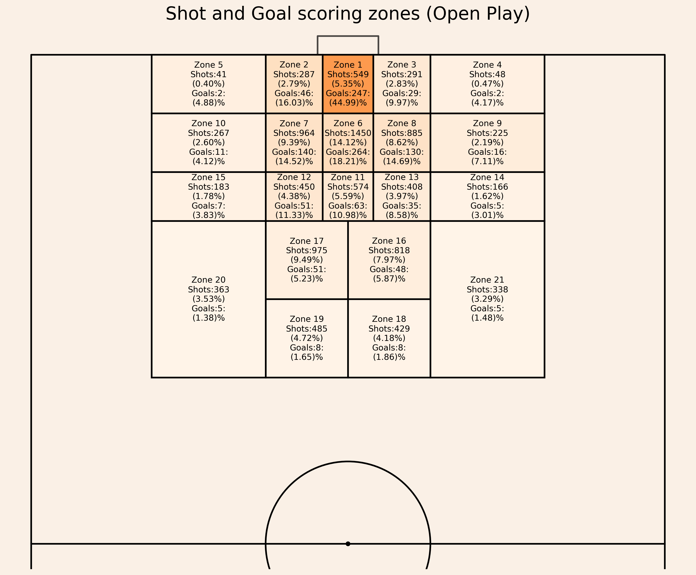
DATASET OVERVIEW
Dataset:
10925 Shots (Open play: 10269, Direct Free kick: 503, Penalty: 148, Direct corner: 5)
Variables/ Features: 'match_minute', 'match_second', 'position_x', 'position_y', 'play_type', 'BodyPart', 'Number_Intervening_Opponents', 'Number_Intervening_Teammates', 'Interference_on_Shooter', 'outcome’
Variables used for Modeling:
'BodyPart', 'Number_Intervening_Opponents’,’ 'Number_Intervening_Teammates’, 'Interference_on_Shooter’, 'x', 'y', 'shot_angle', 'shot_a', 'shot_b', 'shot_c', 'zone’.
Key considerations:
'position_x', 'position_y’ are converted to OPTA co-ordinates 'x', ‘y’.
Body Part mapping: fixed_bodypart_mapping = {'Head': 1, 'Left': 2, 'Right': 3, 'Other': 4 }
Interference_on_Shooter: fixed_interference_mapping = {'Low': 1, 'Medium': 2, 'High': 3}
Zone. mapping: fixed_zone_mapping = { 'Zone 1': 1, 'Zone 2': 2, 'Zone 3': 3, 'Zone 4': 4, 'Zone 5': 5, 'Zone 6': 6, 'Zone 7': 7, 'Zone 8': 8, 'Zone 9': 9, 'Zone 10': 10, 'Zone 11': 11, 'Zone 12': 12, 'Zone 13': 13, 'Zone 14': 14, 'Zone 15': 15, 'Zone 16': 16, 'Zone 17': 17, 'Zone 18': 18, 'Zone 19': 19, 'Zone 20': 20, 'Zone 21': 21, 'Other': 22}
Open play shots, goals Vizualization.
Number of Shots taken, and goals scored from each zone along with the percentage.
Please, refer to “Task – 1 xG (Shot and Goal Viz.).ipynb” for the code.

Slide 5
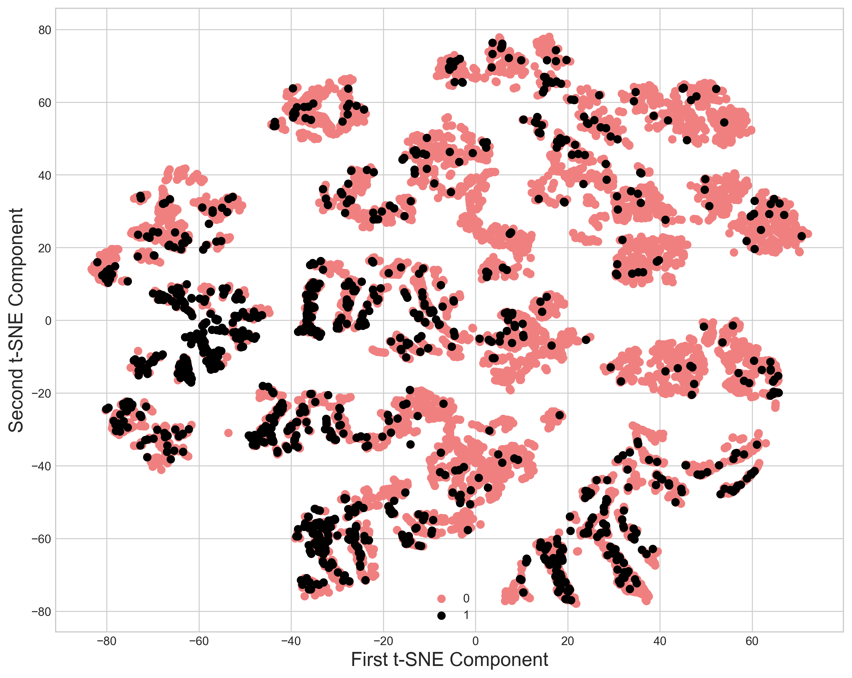
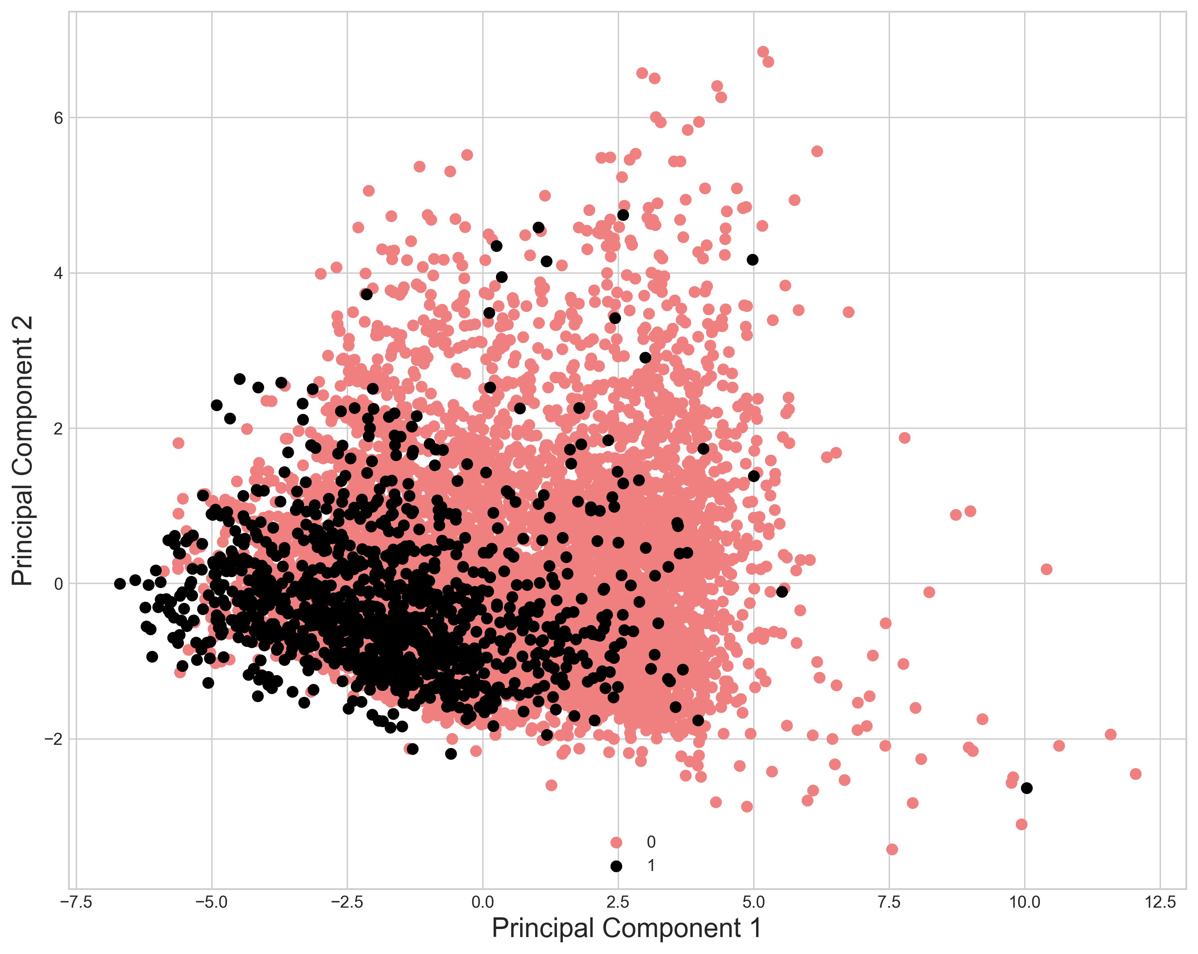
Data VISUALIZATION - 1
PCA
T-SNE
To visualize the open play shot data in a low dimensional space and PCA and t-SNE is used.
PCA reduces the number of dimensions in the data while retaining most of the variance whereas t-SNE captures non-linear relationships in the data.
Please, refer to “Task – 1 xG (Shot and Goal Viz.).ipynb” for the code.

Slide 6
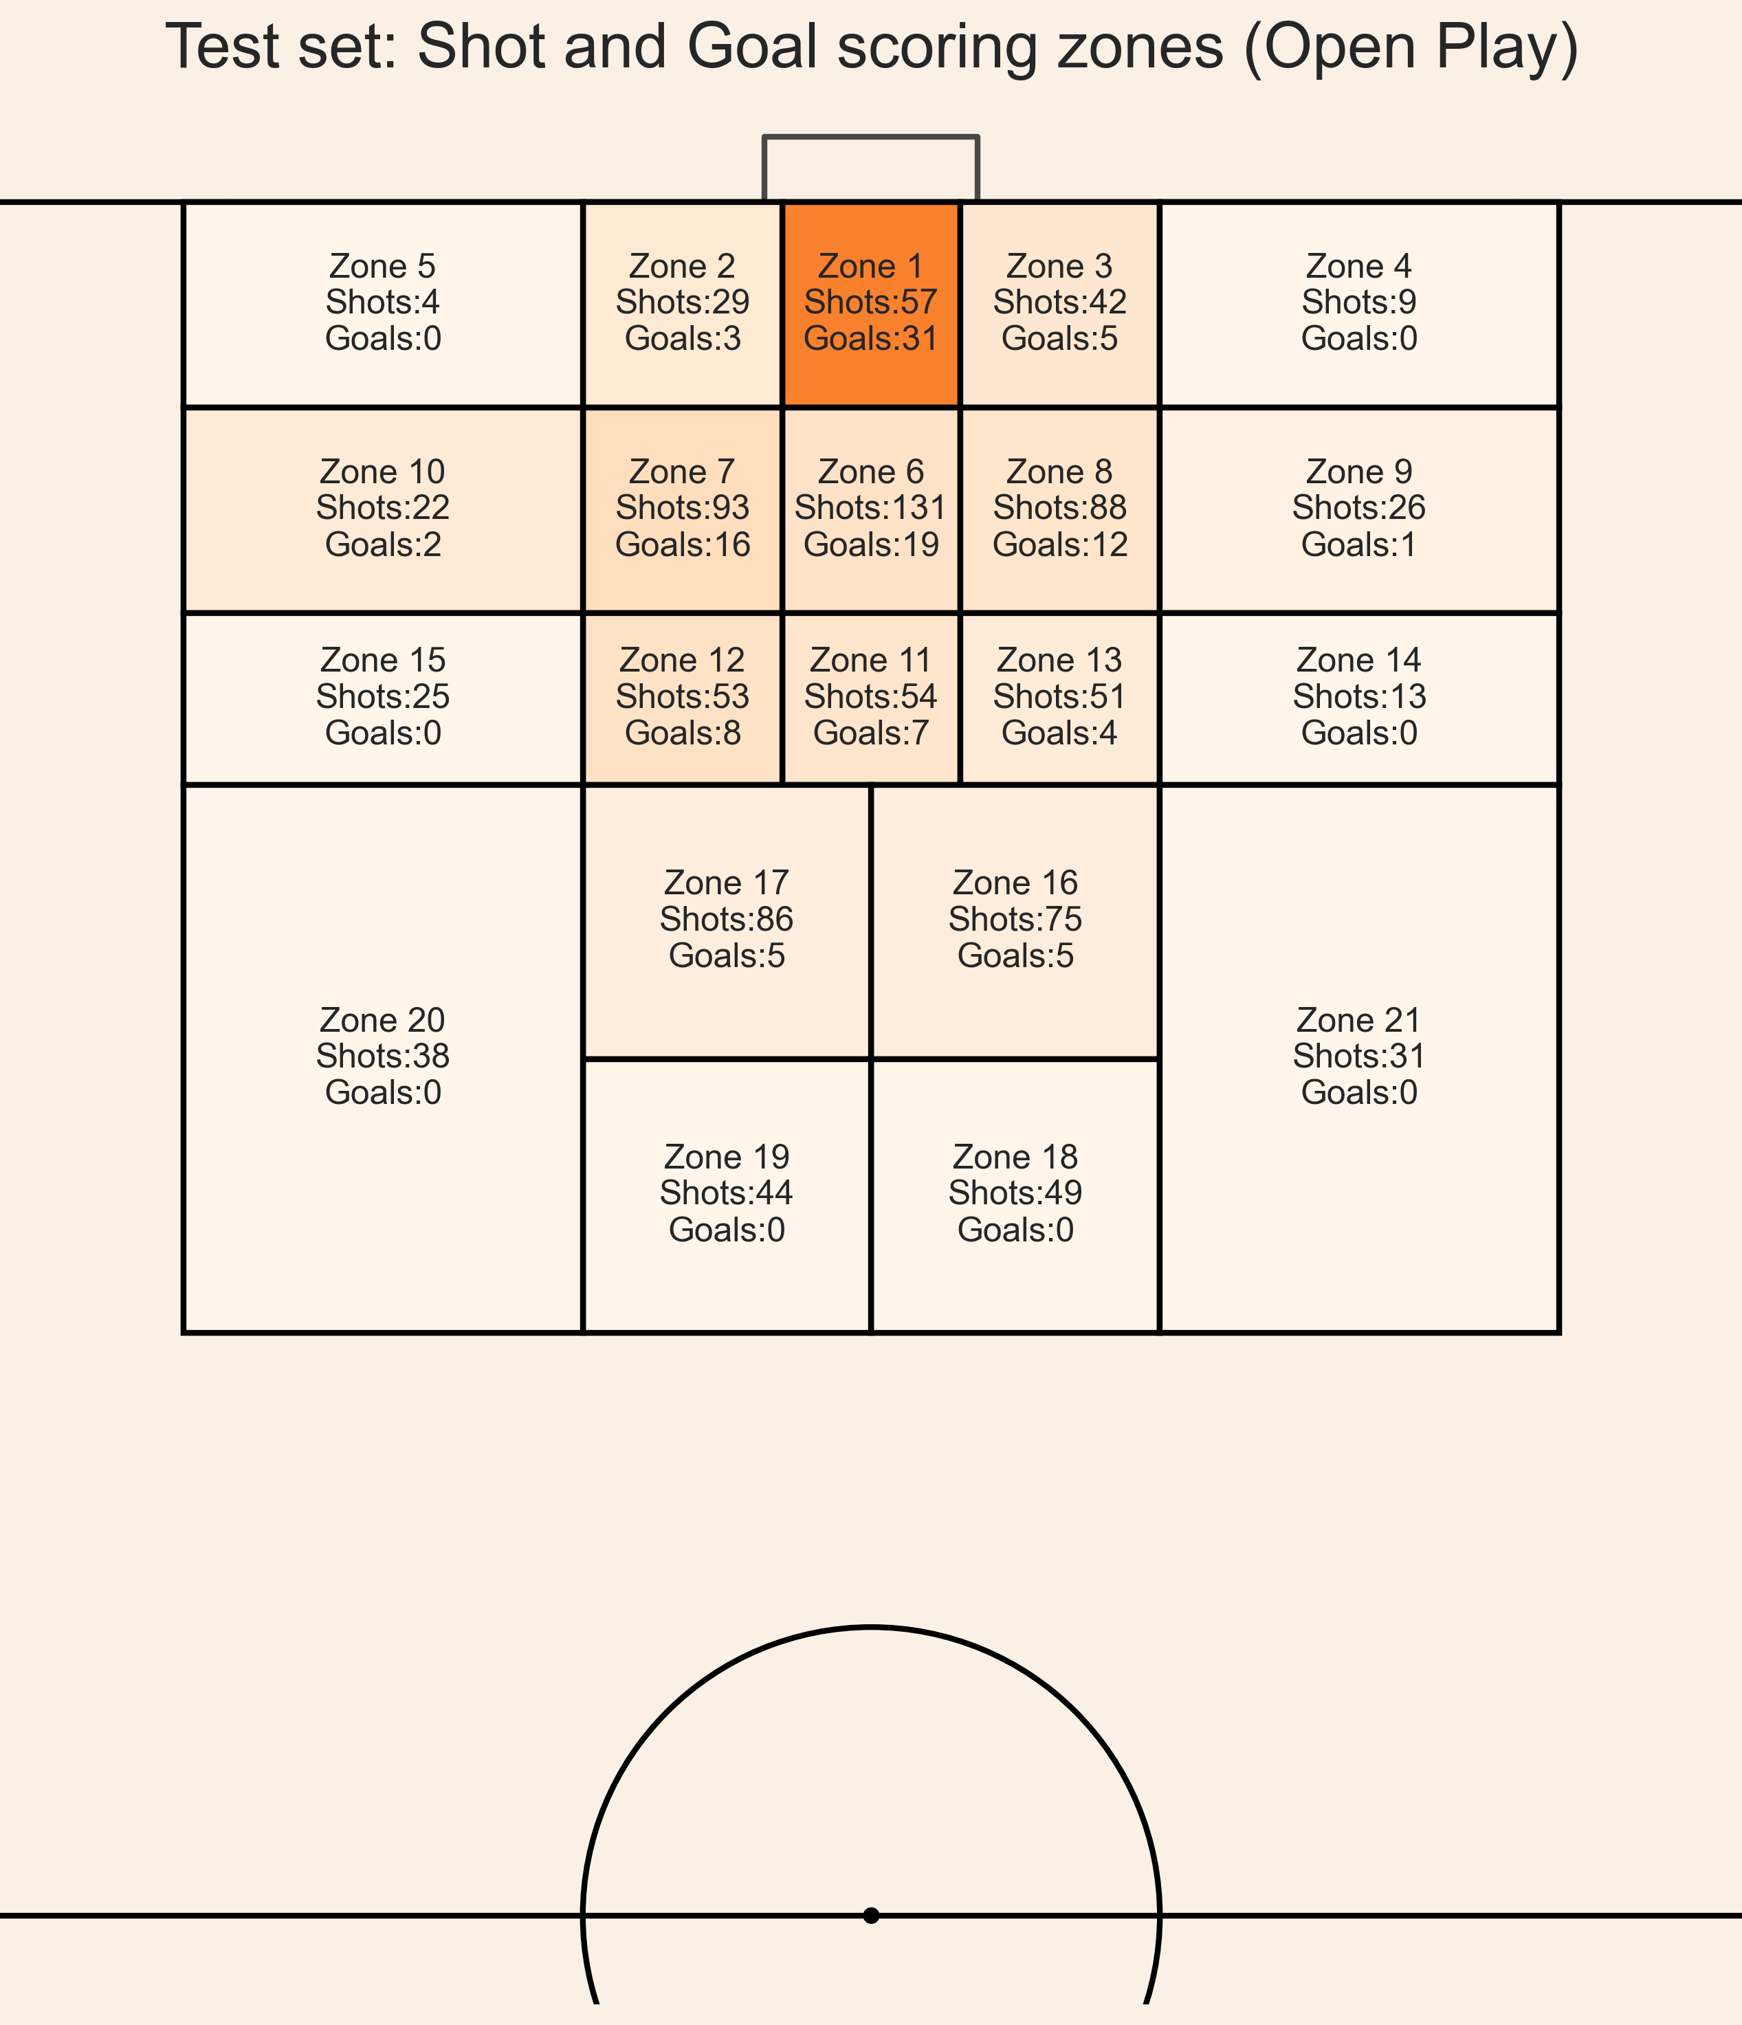
MODEL SELECTION
Three learning algorithms are used:
Logistic Regression (Linear Model) (LOGREG)
XGBoost (Tree Ensemble Model)
Artificial Neural Network (ANN) (uses layers of interconnected neurons to model complex non-linear patterns in data.)
Using these three machine learning models, we will predict the Expected Goal (xG) in each zone of the Test set figure.
The test set comprises 1023 shots, out of which 118 resulted in goals.
The visualizations, later on the slides, will be presented only for XGBoost only.

Slide 7
Model results
Models | RMSE | AUC | BRIER SCORE | xG Predicted | xG Difference (xG Predicted – Actual Goals) | CONFUSION MATRIX
LOGREG (Without sampling) | 0.2877 | 0.60 | 0.082 | 126.59 | 8.59 | 896 | 9
 |  |  |  |  |  | 94 | 24
LOGREG (oversampling SMOTE) | 0.4259 | 0.70 | 0.181 | 374.50 | 256.5 | 673 | 232
 |  |  |  |  |  | 40 | 78
XGBoost (Without sampling) | 0.2865 | 0.60 | 0.081 | 123.85 | 5.85 | 896 | 9
 |  |  |  |  |  | 95 | 23
XGBoost (oversampling SMOTE) | 0.4039 | 0.70 | 0.163 | 342.57 | 224.57 | 701 | 204
 |  |  |  |  |  | 44 | 74
XGBoost (Cost Sensitive) scale_pos_weight = 1.2 | 0.2876 | 0.60 | 0.082 | 140.22 | 22.22 | 894 | 11
 |  |  |  |  |  | 92 | 26
ANN (Without sampling) | 0.2882 | 0.60 | 0.083 | 123.42 | 5.42 | 892 | 13
 |  |  |  |  |  | 92 | 26
ANN (oversampling SMOTE) | 0.4210 | 0.71 | 0.1773 | 393.01 | 275.01 | 673 | 232
 |  |  |  |  |  | 38 | 80
ANN (Cost Sensitive) | 0.2897 | 0.63 | 0.083 | 142.72 | 24.72 | 887 | 18
 |  |  |  |  |  | 86 | 32

Slide 8
Discussion
The test set comprises 1023 shots, out of which 118 resulted in goals.
RMSE, Brier Score, and AUC:
RMSE values range from 0 to 1 when evaluating binary predictions, with lower values indicating better performance.
The Brier score ranges from 0 to 1, where 0 indicates perfect accuracy and 1 indicates the worst possible accuracy.
The AUC ranges from 0 to 1, with an AUC of 0.5 indicating no discriminative power (equivalent to random guessing), and an AUC of 1 indicating perfect discrimination between classes.
Performance Without Sampling:
Logistic Regression, XGBoost, and ANN predicted Expected Goals (xG) of 126.59, 123.85, and 123.42 respectively, resulting in xG differences of 8.59, 5.85, and 5.42.
The RMSE scores are 0.2877, 0.2865, and 0.2882, and the Brier scores are 0.082, 0.081, and 0.082. For instance, an RMSE of 0.2865 means the average deviation of predicted probabilities from actual outcomes is 0.2865. A Brier score of 0.081 indicates that, on average, the squared error between predicted probabilities and actual outcomes is 0.081.
Performance with Oversampling SMOTE:
XGBoost and ANN with oversampling SMOTE have AUC values of 0.70 and 0.71, respectively, and balanced predictions in the confusion matrix. However, the RMSE is significantly higher, suggesting overprediction. The xG predicted by these models are 342.57 and 393.01.
Cost-sensitive Models:
Cost-sensitive models with XGBoost and ANN have RMSE values of 0.2876 and 0.2897, Brier scores of 0.082 and 0.083, and AUC values of 0.60 and 0.63, respectively.
Conclusion:
The confusion matrix, along with the classification report and AUC, can be misleading. It is crucial to calculate RMSE and Brier scores to comprehensively evaluate the Expected Goals (xG) model and assess the scoring probability of each shot accurately.

Slide 9
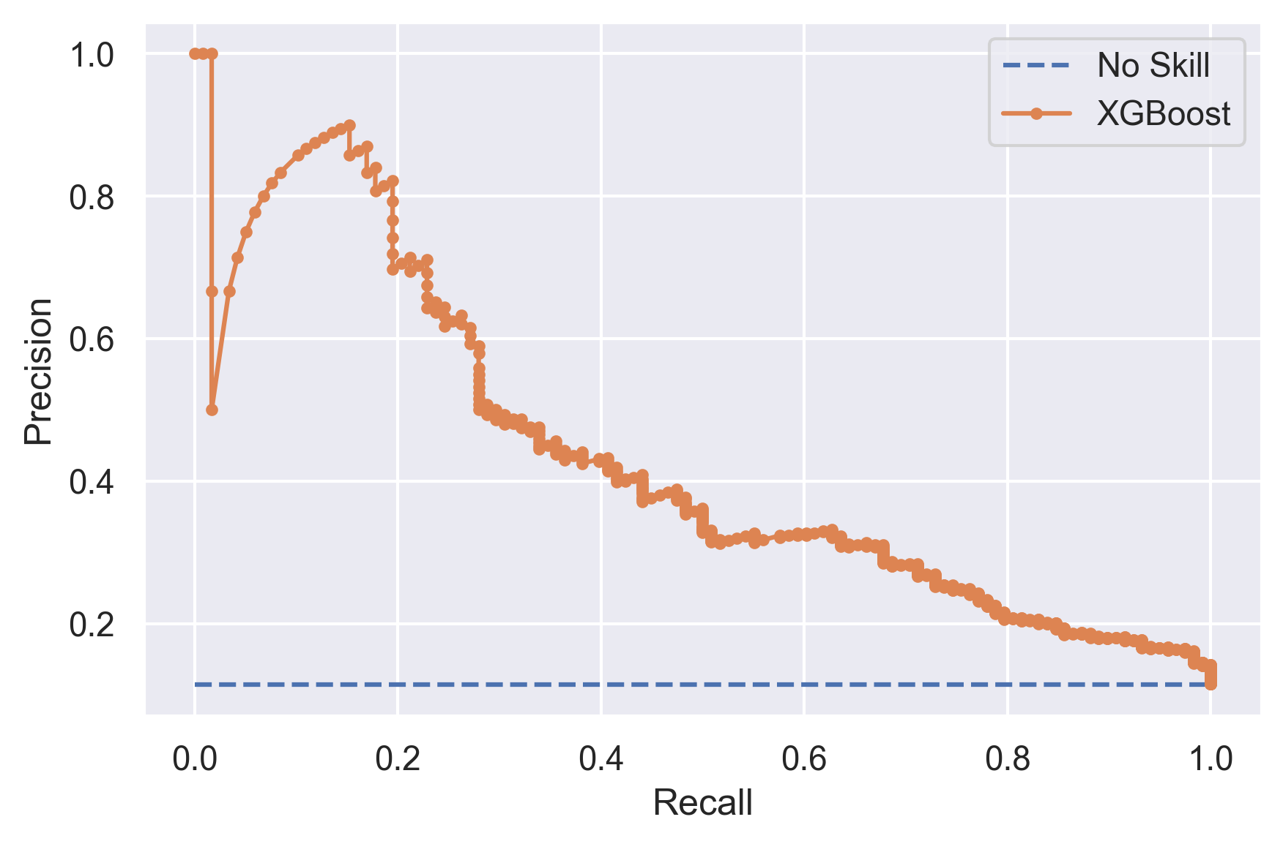
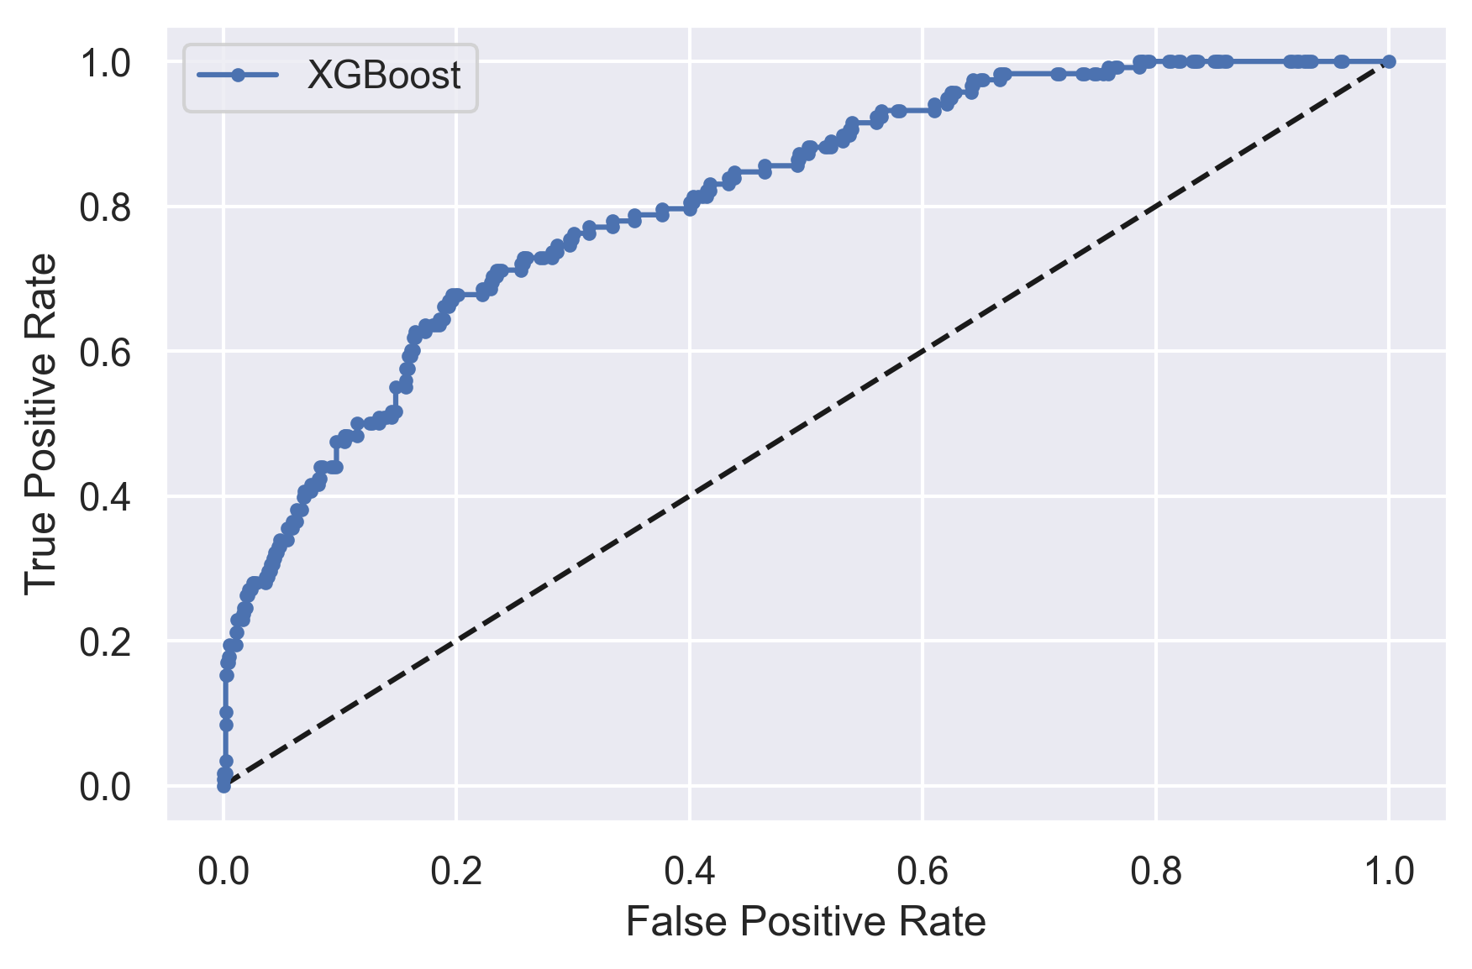
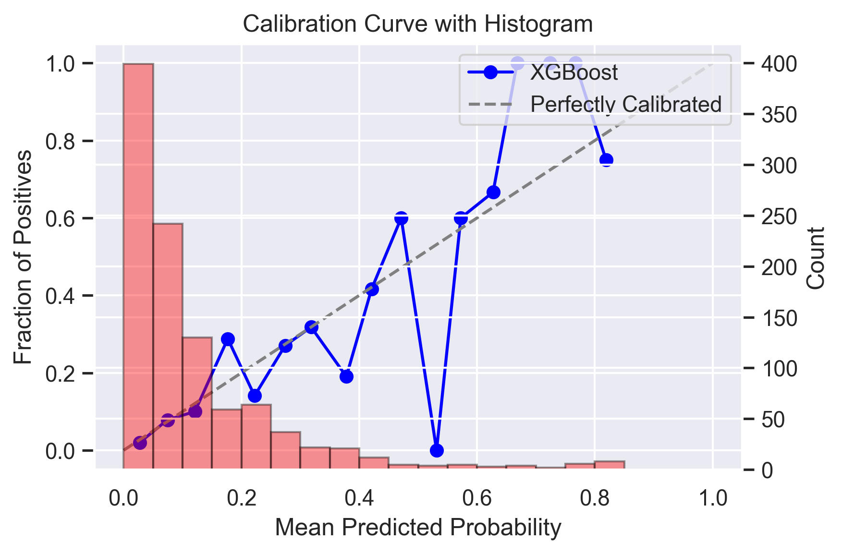
Model Evaluation
Precision-Recall Curve:
The precision-recall curve is used to evaluate the performance of classification models, particularly for imbalanced datasets.
The XGBoost model is represented by the orange line, while the No Skill model (baseline) is shown as a dashed blue line.
The XGBoost curve starts with high precision at low recall levels, indicating that the model is very accurate when it makes positive predictions. However, as recall increases, precision decreases, suggesting an increasing rate of false positives as the model tries to identify more actual positives.
ROC-AUC Curve:
The ROC (Receiver Operating Characteristic) curve evaluates the diagnostic ability of a binary classifier system.
XGBoost Model: Represented by the solid blue line. The curve starts at the origin (0,0) and moves towards the top right corner (1,1).Random Classifier: Represented by the dashed black diagonal line, which indicates the performance of a random guesser (AUC = 0.5).
The XGBoost model's ROC curve is above the diagonal line, indicating better performance than random guessing.The curve shows that the XGBoost model achieves a high true positive rate while maintaining a relatively low false positive rate, especially in the early part of the curve.
Calibration Curve with Histogram:
The calibration curve assesses how well the predicted probabilities of a classification model align with the actual outcomes. It is crucial for evaluating the reliability of probabilistic predictions.
The histogram complements the calibration curve by showing the distribution of predicted probabilities.
The blue line represents the calibration curve of the XGBoost model. The dashed diagonal line represents a perfectly calibrated model where the predicted probabilities match the actual probabilities (y = x).
The XGBoost model shows good calibration in some ranges but deviates from the perfect calibration line in others. For example, at lower predicted probabilities (around 0.1), the model closely follows the perfect calibration line, indicating accurate probability estimation in this range.
However, the model overestimates the probabilities around the 0.6 mark, as indicated by the spike in the curve. Also, the model underestimates slightly the probabilities around the 0.2 and o.4 mark, as indicated by the curve.

Slide 10
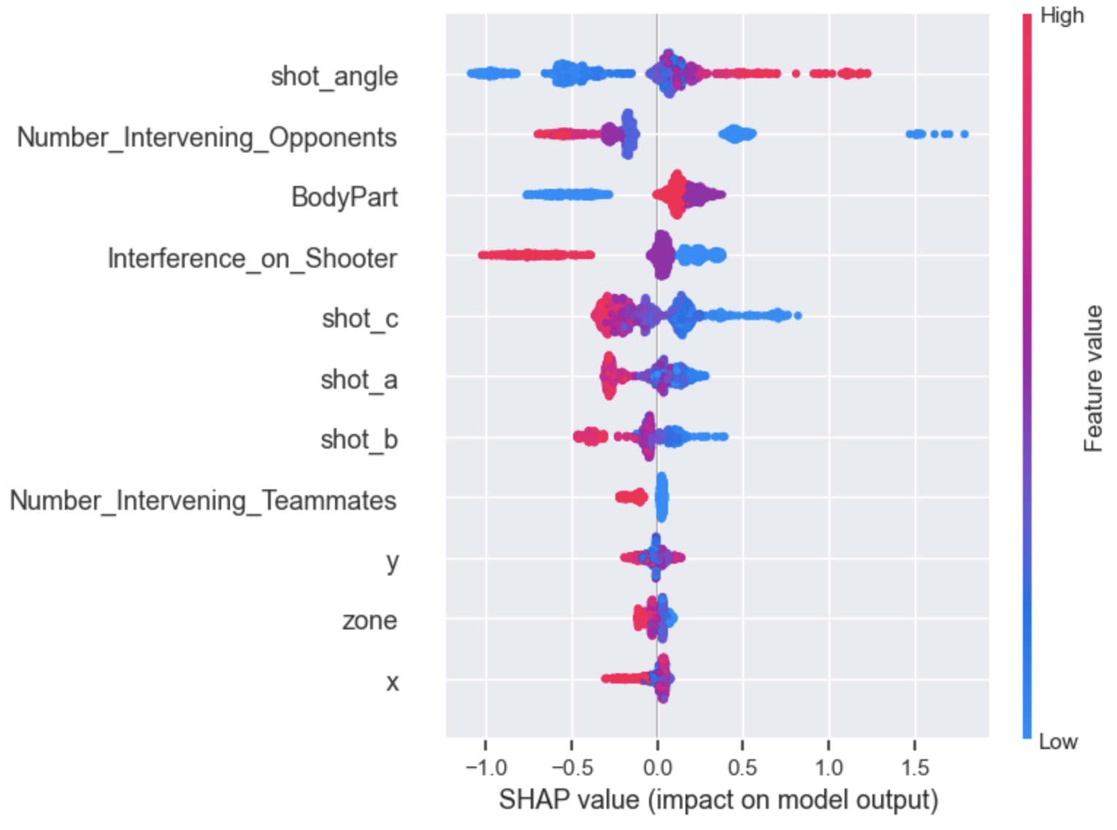
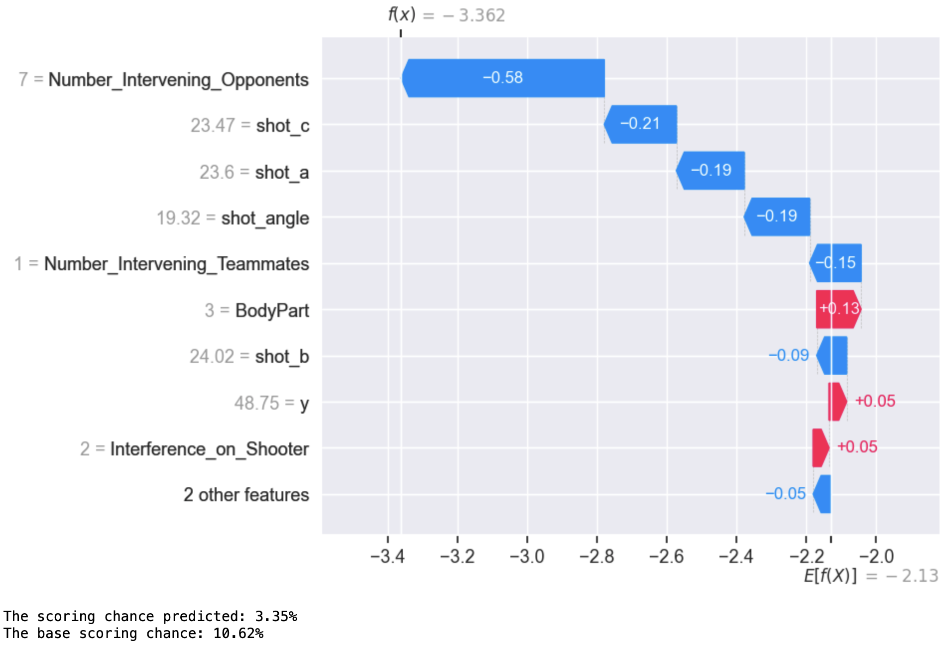
Model Explainability
Overall Feature Importance
Single Shot prediction feature contribution
The above example is a shot from the test data. As it can be seen that the high number of intervening opponents (e.g., 7) and low shot angle (e.g., 19.32) lower the probability of scoring chance.
F(x) and E[f(x)] represent log-odds. Below they are converted to probability and multiplied with 100. The baseline is 10.62% and the scoring chance predicted 3.35%.
Top 3 Predictive Features: Shot angle, number of intervening opponents, and body part.
Shot Angle: Lower shot angles reduce the probability of scoring, while higher shot angles increase it.
Intervening Opponents: Fewer intervening opponents correlate with a higher probability of scoring.

Slide 11
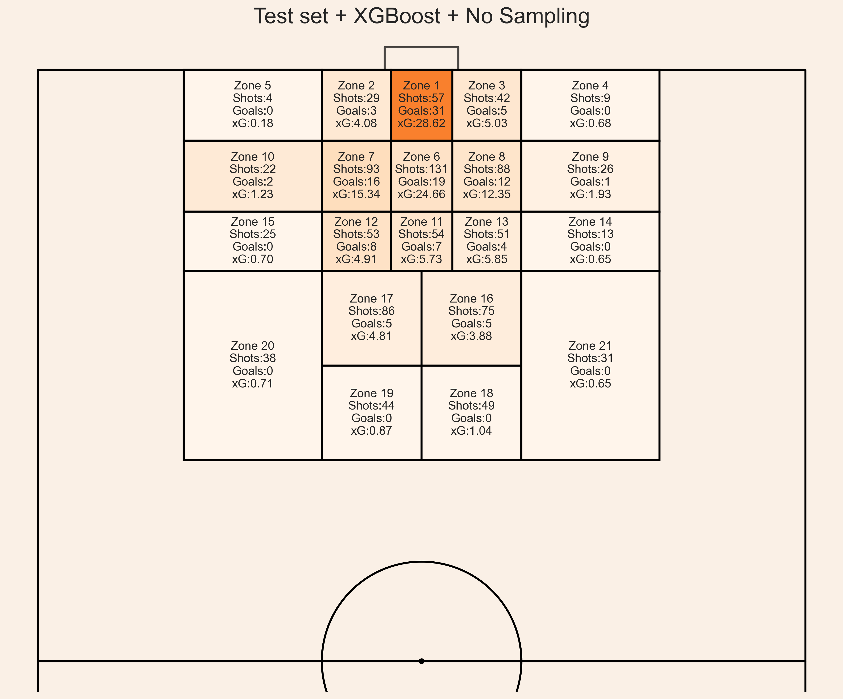
Test set Prediction
High Accuracy Zones:
Zone 1: Predicted xG (28.62) closely matches actual goals (31), indicating high model accuracy in this critical scoring area.
Zone 3 & Zone 11: Predicted xG (5.03, 5.73) aligns well with actual goals (5, 7), reflecting good calibration.
Overestimated Zones:
Zone 2 & Zone 9: Predicted xG (4.08, 1.93) overestimates actual goals (3, 1), suggesting the model expects more goals than observed.
Zone 6: Significant overestimation with predicted xG (24.66) compared to actual goals (19).
Underestimated Zones:
Zone 12 & Zone 16: Predicted xG (4.91, 3.88) underestimates actual goals (8, 5), indicating conservative scoring estimates by the model.
Zero Goals Zones:
Zones 4, 5, 13, 14, 15, 18, 19, 20, 21: Predicted xG values range from 0.18 to 1.04, but no goals were scored, indicating overestimation or strong defensive performance.
Concentration of Shots:
Zone 6 & Zone 7: High volume of shots (131, 93) with significant actual goals (19, 16) and high predicted xG (24.66, 15.34), suggesting these are crucial scoring zones.

Slide 12
Additional Insights with Cross-validation
Models | 10-Fold RMSE | 10-Fold AUC | 10-Fold BRIER SCORE
XGBoost Without sampling | 0.292 | 0.561 | 0.085
XGBoost Cost-sensitive | 0.293 | 0.572 | 0.086
ANN Without sampling | 0.290 | 0.578 | 0.084
ANN Cost-sensitive | 0.286 | 0.61 | 0.082
So far, we have analyzed the xG model on a fixed subset to evaluate different machine learning models and their effectiveness in predicting expected goals (xG). However, it is equally important to test the model on various subsets of the data to ensure its robustness.
To achieve this, I manually created 10 subsets (i.e., folds) of the data and evaluated the machine learning models using 10-fold cross-validation. The table below presents the average results for RMSE, Brier score, and AUC.
Key Findings:
Cost-sensitive ANN: This model achieved the lowest RMSE of 0.285, the lowest Brier score of 0.082, and a better AUC of 0.61 compared to other models.
Data Utilized: The model was trained using only 10,269 open-play shots.
Future Directions:
Improving Model Performance: Achieving better AUC scores (e.g., greater than 0.70), RMSE scores less than 0.28, and Brier scores less than 0.082 is possible with more extensive shot data. Increasing the dataset size to approximately one million shots can significantly enhance model performance and reliability.
Please refer to “Task 1 - xG - (XGBoost) [Cross-Validation].ipynb” and “Task 1 - xG - (ANN) [Cross-Validation].ipynb” for in-detail results and Visualization for each subset (i.e., Fold).
The Model with “XGBoost without sampling” and “ANN Cost-sensitive” for prediction in Task -2.

Slide 13
Conclusion
Why Choose XGBoost, Artificial Neural Networks (ANN), and Logistic Regression for Predictive Modeling?
Diverse Learning Approaches: These three algorithms represent different learning methodologies. Comparing their results helps in evaluating their predictive capabilities. (Refer to Slide 6)
What Are the Key Evaluation Metrics for Assessing Machine Learning Model Performance?
Essential Metrics: RMSE, BRIER Score, and AUC are critical. Desirable models exhibit low RMSE, low BRIER Score, and high AUC. (Refer to Slide 8)
Which Variables Significantly Influence the Likelihood of a Shot Resulting in a Goal?
Key Predictors: Shot angle, number of intervening opponents, and body part are significant predictors of shot outcomes. However, incorporating additional variables (e.g., distance to goalkeepers, previous event type, possession chain) can enhance predictive accuracy.
What Is Our Objective: Predicting the Majority of Goals or Estimating the Probability of Each Shot?
Objective: Our primary goal is to closely estimate the probability of each individual shot.

